Slide 1
Point-Time Locked Contracts

Slide 2
From HTLCs to PTLCs
Incentive:
Hash-Time Locked Contracts (HTCLs)
reduce privacy due to the same hash being forwarded on a route
require block space for the hash and preimage check
Prerequisites:
Point-Time Locked Contracts (PTLC) require Schnorr signature adaptors
Disadvantage:
Unavailability of Schnorr signatures in alternative cryptocurrencies may prevent use of PTLCs in cross-chain contracts

Slide 3
Benefits detail
PTLC: Coins are locked using a public key (a point on Bitcoin’s elliptic curve) and unlocked by providing a corresponding signature from a satisfied signature adaptor. For a proposed Schnorr signature construction, the key would be 32 bytes and the signature 64 bytes. However, using either multiparty ECDSA or Schnorr key aggregation and signing, the keys and signature can be combined with other keys and signatures needed to authorize any spend, allowing point locks to use zero bytes of distinct block space.
Each point lock can use different keys and signatures, so there is nothing about the point lock that correlates different payments either on-chain or when routed off-chain through surveillance nodes.

Slide 4
Adaptor signatures
Using Schnorr signatures:
Alice creates a valid signature commitment 𝑠_{A} for the transaction 𝑚_{A} paying Bob using her private key 𝑥_{A}, which corresponds to her public key 𝑌_{A} = 𝑥_{A} ⋅ 𝐺. She also uses a private random nonce 𝑘_{A} with 𝑅_{A} = 𝑘_{A} ⋅ 𝐺 and a hidden value 𝑡_{A} with the adaptor 𝑇_{A} = 𝑡_{A} ⋅ 𝐺
𝑒_{A} := H(𝑅_{A} + 𝑇_{A} ∥ 𝑌_{A} ∥ 𝑚_{A})
𝑠_{A} := (𝑘_{A} + 𝑡_{A} + 𝑥_{A} 𝑒_{A})
She subtracts 𝑡_{A} from the signature commitment to produce a signature adaptor (a tweaked signature):
𝑠_{A}’ = 𝑠_{A} - 𝑡_{A}
She gives Bob the adaptor, which consists of the following data:
𝑠_{A}’, 𝑅_{A}, 𝑇_{A}
https://bitcoinops.org/en/topics/adaptor-signatures/

Slide 5
Adaptor signatures
Bob can verify the adaptor:
𝑠_{A}’ ⋅ 𝐺 ≟ 𝑅_{A} + H(𝑅_{A} + 𝑇_{A} ∥ 𝑌_{A} ∥ 𝑚_{A}) ⋅ 𝑌_{A}
Important: Alice’s adaptor 𝑠_{A}’ is not a valid signature according to BIP340 because this expects
𝑠 ⋅ 𝐺 ≟ 𝑋 + H( 𝑋 ∥ 𝑌 ∥ 𝑚 ) ⋅ 𝑌
Bob creates his adaptor for his transaction 𝑚_{B} with 𝑘_{B}:
𝑒_{B} := H(𝑅_{B} + 𝑇_{A} ∥ 𝑌_{B} ∥ 𝑚_{B})
𝑠_{B}’ := (𝑘_{B} + 𝑥_{B} 𝑒_{B})
Bob gives Alice his adaptor (it does not need to be tweaked):
𝑠_{B}’, 𝑅_{B}, 𝑇_{A}
Alice can verify the adaptor:
𝑠_{B}’ ⋅ 𝐺 ≟ 𝑅_{B} + H(𝑅_{B} + 𝑇_{A} ∥ 𝑌_{B} ∥ 𝑚) ⋅ 𝑌_{B}
Important: Bob’s adaptor 𝑠_{B}’ is also not a valid signature according to BIP340
https://bitcoinops.org/en/topics/adaptor-signatures/

Slide 6
Adaptor signatures
Alice can produce a valid signature from Bob’s adaptor 𝑠_{B}’ using the hidden value 𝑡_{A} that only she knows so far:
(𝑠_{B}’ + 𝑡_{A}) ⋅ 𝐺 ≟ 𝑅_{B} + 𝑇_{A} + H(𝑅_{B} + 𝑇_{A} ∥ 𝑌_{B} ∥ 𝑚) ⋅ 𝑌_{B}
Alice uses the signature to broadcast Bob’s transaction that pays her.
When Bob sees (𝑠_{B}’ + 𝑡_{A}) on-chain, he can learn the value of 𝑡_{A}:
𝑡_{A} = (𝑠_{B}’ + 𝑡_{A}) - 𝑠_{B}’
He can then use 𝑡_{A} to solve the adaptor 𝑠_{A}’ Alice gave him earlier:
(𝑠_{A}’ + 𝑡_{A}) ⋅ 𝐺 ≟ 𝑠_{A} ⋅ 𝐺 = 𝑅_{A} + 𝑇_{A} + H(𝑅_{A} + 𝑇_{A} ∥ 𝑌_{A} ∥ 𝑚) ⋅ 𝑌_{A}
Bob uses that signature to broadcast the transaction Alice originally gave him.
https://bitcoinops.org/en/topics/adaptor-signatures/

Slide 7
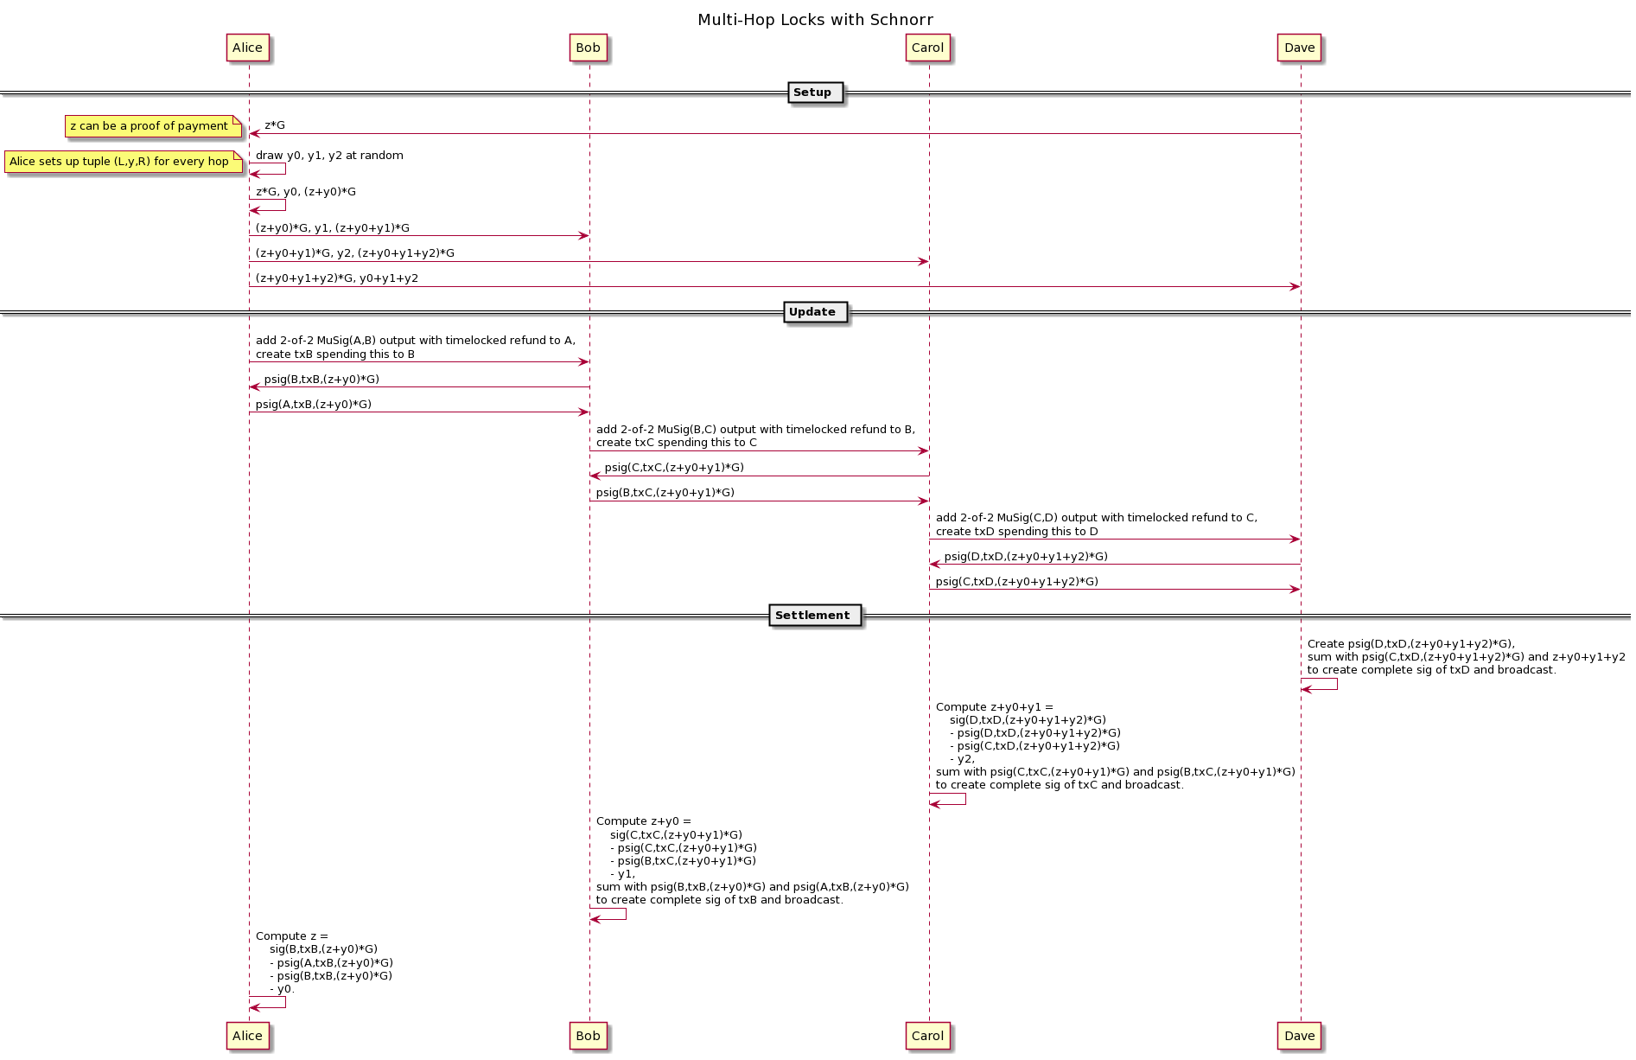
Multi-Hop Locks from Scriptless Scripts
https://github.com/ElementsProject/scriptless-scripts/blob/master/md/multi-hop-locks.md

Slide 8
Multi-Hop Locks from Scriptless Scripts
Note: In case of multi-signature schemes based on Schnorr signatures (MuSig*), the partial signatures plus the adaptor secret add up to the valid signature for 𝑚:
𝑠(𝑚, 𝑧_{D}) ≔ 𝑠_{A}’(𝑚) + 𝑠_{B}’(𝑚) + 𝑧_{D}
Setup:
The payment recipient (Dave) uses an adaptor secret 𝑧_{D} to create an adaptor 𝑍_{D} = 𝑧_{D} ⋅ 𝐺 which he hands over to the payment sender (Alice). Note that 𝑧_{D}
is like a preimage of HTLCs and
will be revealed to the payment sender (Alice) if the payment went through (in case of on-chain settlement).
The payment sender (Alice) creates a random number 𝑦_{i} for herself plus for each hop (Bob and Carol).
* for correct implementation of MuSig, 𝑐 = H(𝑅_{comb} ∥ 𝑌_{comb} ∥ 𝑚)

Slide 9
Multi-Hop Locks from Scriptless Scripts
The payment sender (Alice) sets up a tuple (𝐿_{i}, 𝑦_{i}, 𝑅_{i}) consisting of the left lock 𝐿_{i} and right lock 𝑅_{i} for every node i in the following way:
a left lock 𝐿_{i}
for herself with 𝑍_{D} which she previously received from the payment recipient (Dave),
for node 0 < i ⩽ n with 𝐿_{i} ≔ 𝑅_{i-1}
a right lock 𝑅_{i} for node 0 ⩽ i < n with 𝑅_{i} ≔ 𝐿_{i} + 𝑦_{i} ⋅ G
Hence, the payment sender (Alice)
has the tuple (𝐿_{A}, 𝑦_{A}, 𝑅_{A}) = (𝑍_{D}, 𝑦_{A}, 𝑍_{D} + 𝑦_{A} ⋅ G) for herself,
and sends
(𝐿_{B}, 𝑦_{B}, 𝑅_{B}) = (𝑅_{A}, 𝑦_{B}, 𝑅_{A} + 𝑦_{B} ⋅ G ) to the 1st router (Bob),
(𝐿_{C}, 𝑦_{C}, 𝑅_{C}) = (𝑅_{B}, 𝑦_{C}, 𝑅_{B} + 𝑦_{C} ⋅ G ) to the 2nd router (Carol), and
𝑅_{C} , (𝑦_{A} + 𝑦_{B} + 𝑦_{C}) to the payment receiver (Dave)

Slide 10
Multi-Hop Locks from Scriptless Scripts
Update:
The payment sender (Alice)
creates a 2-of-2 MuSig(A,B) output 𝑌_{A,B} with timelocked refund to herself,
creates a TX_{A,B} spending the output 𝑌_{A,B} to the 1st router (Bob) and
sends TX_{A,B} to the 1st router (Bob).
TX_{A,B} gets partially signed
by the 1st router (Bob): 𝑠_{B}’ ≔ 𝑦_{B} + 𝑥_{B} H(𝐿_{B} + 𝑦_{B} ⋅ G ∥ 𝑌_{A,B} ∥ 𝑚₁=TX_{A,B}) with 𝐿_{B} = 𝑍_{D} + 𝑦_{A} ⋅ G who sends it back to the payment sender (Alice), and
by the payment sender (Alice): 𝑠_{A}’ ≔ 𝑦_{A} + 𝑥_{A} H(𝑅_{A} ∥ 𝑌_{A,B} ∥ 𝑚₁=TX_{A,B}) with 𝐿_{B} = 𝑅_{A} who sends it to the 1st router (Bob).
If the 1st router (Bob) learns the adaptor secret 𝑧_{D}, he can claim TX_{A,B} by signing with (𝑠_{A}’ + 𝑠_{B}’ + 𝑧_{D} , 𝐿_{B}) which evaluates to a valid signature
𝑠_{A}’ + 𝑠_{B}’ + 𝑧_{D} = (𝑧_{D} + 𝑦_{A} + 𝑦_{B}) + (𝑥_{A} + 𝑥_{B} ) * H(𝑍_{D} + 𝑦_{A} ⋅ G ∥ 𝑌_{A,B} ∥ 𝑚₁=TX_{A,B})

